Slide 1
How does the central engine duration influence the properties of GRBs relativistic jets?
Hamid Hamidani
Tokyo University, PhD student
(D3. Umeda Laboratory)
GRB Workshop - September 1, 2015

Slide 2
Collapsar Model
Gravitational collapse of massive stars producing central BH (engine) is believed to power LGRBs as:
It can power relativistic jets (Γ>100) (Numerical simulations)
GRBs are observed in high SFR regions (Savaglio et al., 2009)
  GRB => Young/Massive Stars death
GRB-SN connections (SN1998bw, SN2006aj, SN2010bh…)
(Credit: T. Totani)
MacFadyen et al., 1999 & Woosley et al., 2006

Slide 3
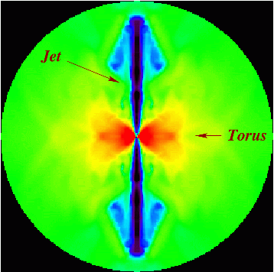
Open issues
The collapsar explains the “why” of GRBs, but two main issues about the “how” are still in debate:
(1) How does the central engine work and power the jet?
(2) How does the jet radiate and produce the prompt emission after breaking out?
Morsony et al., 2006

Slide 4
Previous Numerical Studies
Numerical simulation of Collapsar jets explain most of GRBs properties:
  Aloy et al., 2000, Mizuta et al., 2006, 2009, 2011, Morsony et al., 2007, Lazzati et al., 2010, 2011, 2013, Ito et al., 2014…
Three phases : Precursor, Shocked and Unshocked
  (Zhang et al., 2003, Lazzati et al., 2007 & Morsony et al., 2007)
Previously used types of engine/injection:
  Steady, Variable (Morsony et al., 2014), Short (Mizuta et al., 2006), & Precession (Ito et al., 2014)
  But, most studies focused on engines duration in the range 30-100 sec

Slide 5
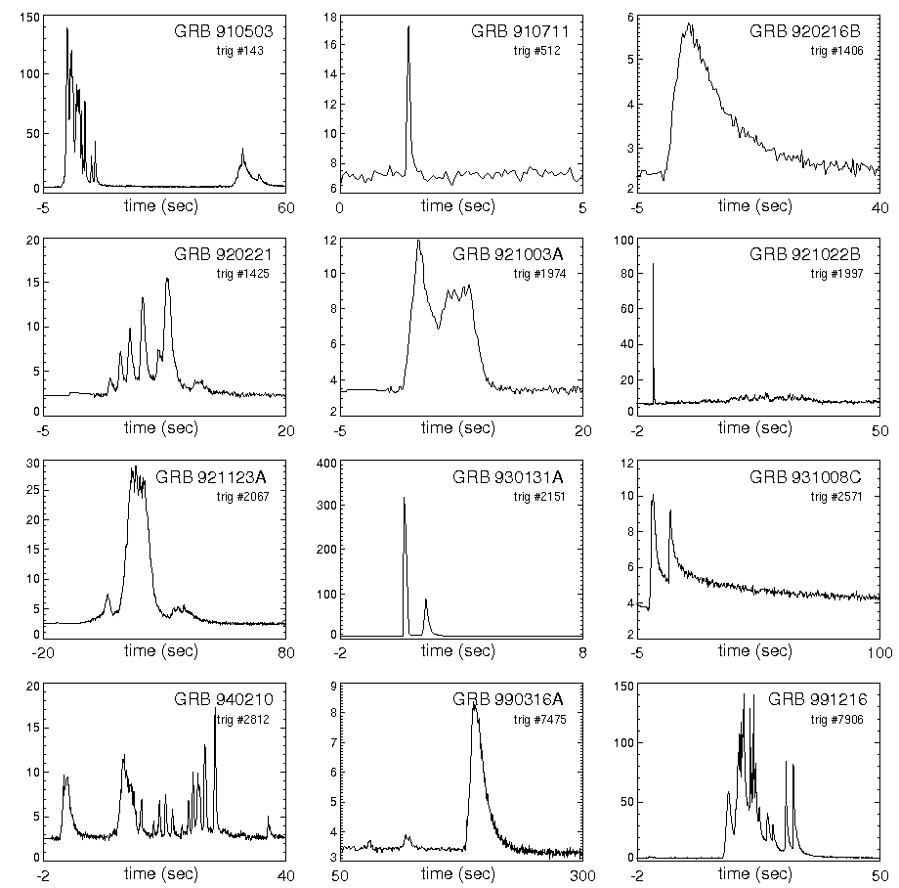
Research plan
The Collapsar doesn’t exclude short engines, or make strong restrictions on the engine duration
And, GRBs diversity suggest that shorter engines, are very present (Lazzati et al., 2010)
We investigate different jets driven by different Engine/Injection durations:
  0.1-100s for a fixed total injected energy (1.10⁵² ergs)
Analyze the effect of the Engine duration on:
  Energies/luminosities, Temporal & Angular properties…
Credit: BATSE catalog (NASA)
(http://gammaray.msfc.nasa.gov/batse/grb/catalog/)

Slide 6
Method
Code:
  We employ a 2D HD AMR code (Okita et al., 2014)
  Follow the jet for 100 sec
Stellar Model
  As a progenitor we use an initially 25 solar mass WR star
  R ~ 3.3×10¹⁰ cm (Umeda et al., 2005)
Jet Initial conditions:
  θ_{op} = 10 deg
  f_{th} = 0.975
  Γ₀ = 5
Grid:
  R_{in} = 10⁸ to R_{out} = 3.01 10¹² cm (∆r_{min} = 9.7×10⁶ cm to ∆r_{max} = 10¹⁰ cm )
  N_{θ} = 256 (from ∆θ₀ = 0.088° to ∆θ_{max} = 0.896°)

Slide 7
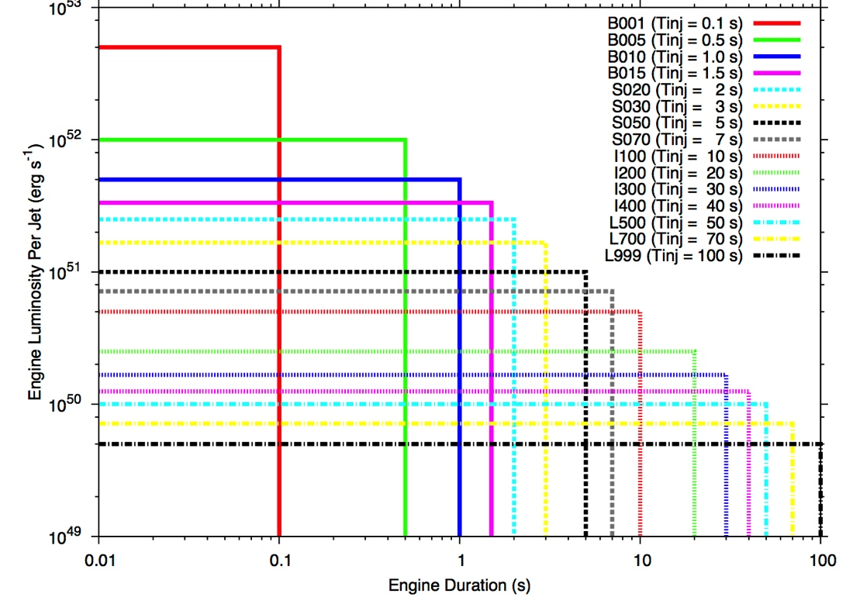
Engine Models
Intermediate
Long
Short
Covers a large diversity in both engine duration and luminosity

Slide 8
Breakout & Phases

Slide 9
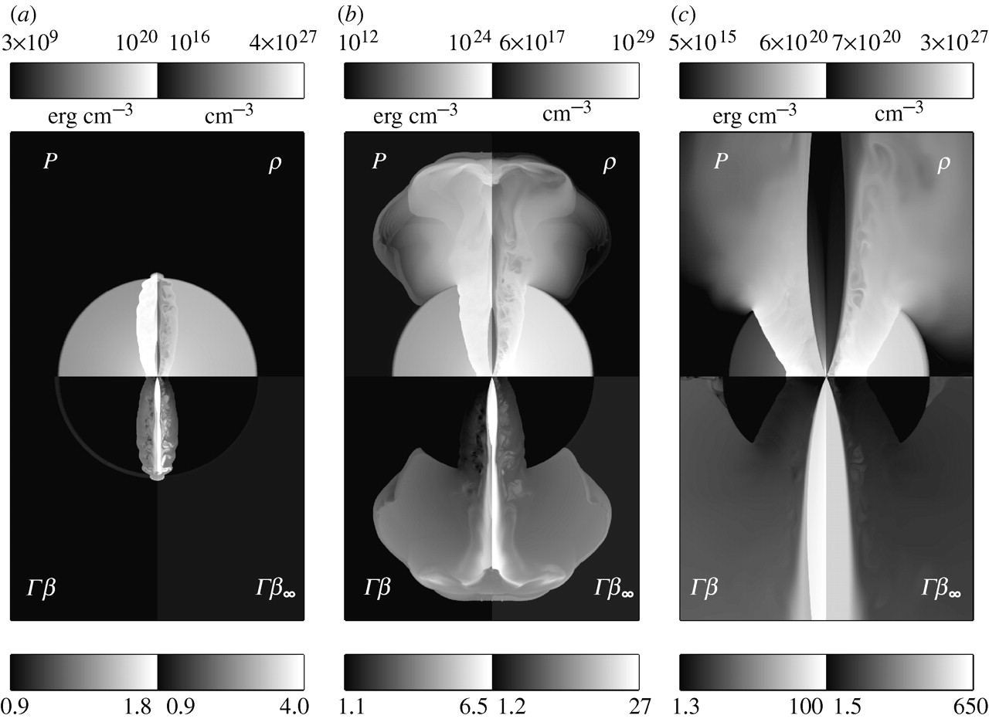
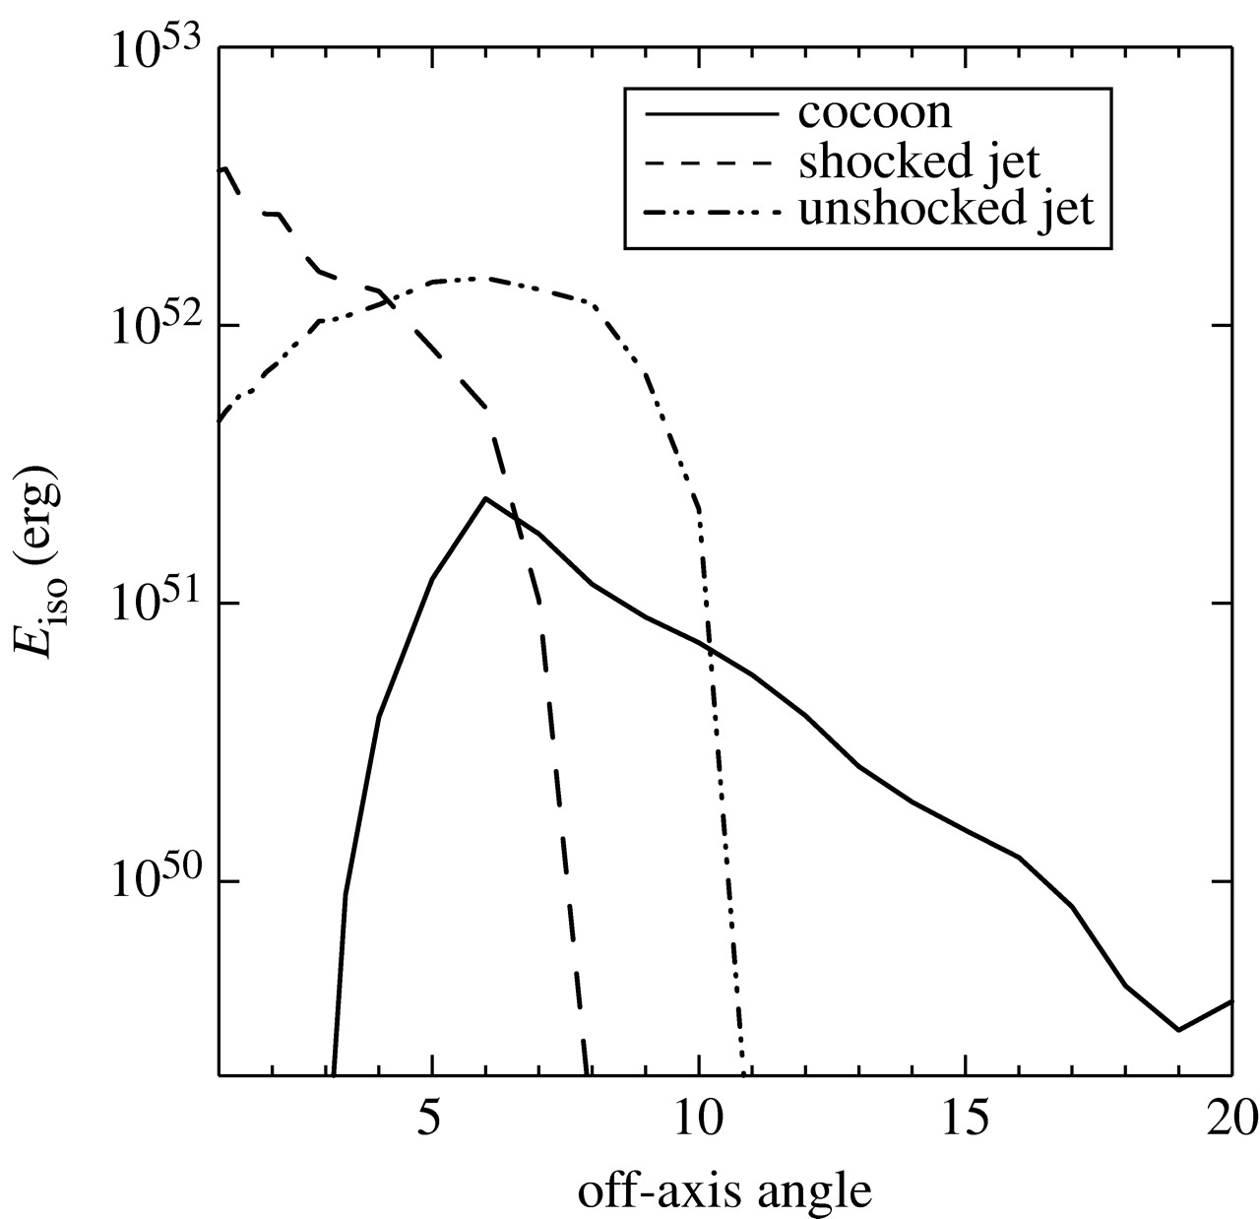
Jet Phases (review)
1- Precursor phase: the breakout shock
  Nearly isotropic
2- Shocked-jet phase: fully shocked and turbulent jet emerge (strong jet-star interaction)
  Narrow jet, highly variable and relativistic
3 - Unshocked-jet phase: free-streaming, unshocked outflow
  Steady flow (reflecting the energy injection)
  Width increasing with time (jet is free streaming)
  Highly relativistic
Credit: Lazzati et al., 2007 (http://rsta.royalsocietypublishing.org/content/365/1854/1141)

Slide 10
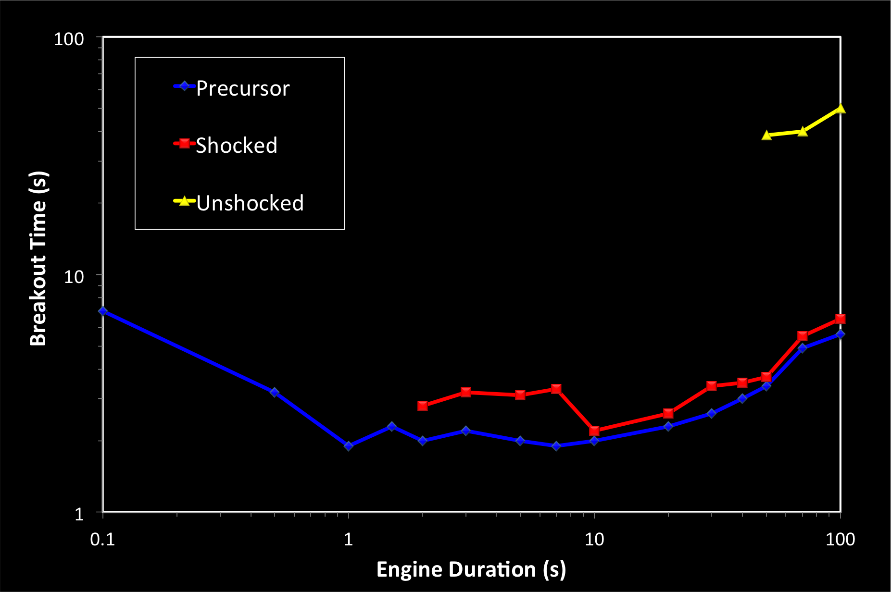
Breakout Properties
Too short/long engines are slower at breaking out
Engines of about few seconds are the fastest at breaking out
Only long engines are capable of lunching the unshocked phase

Slide 11
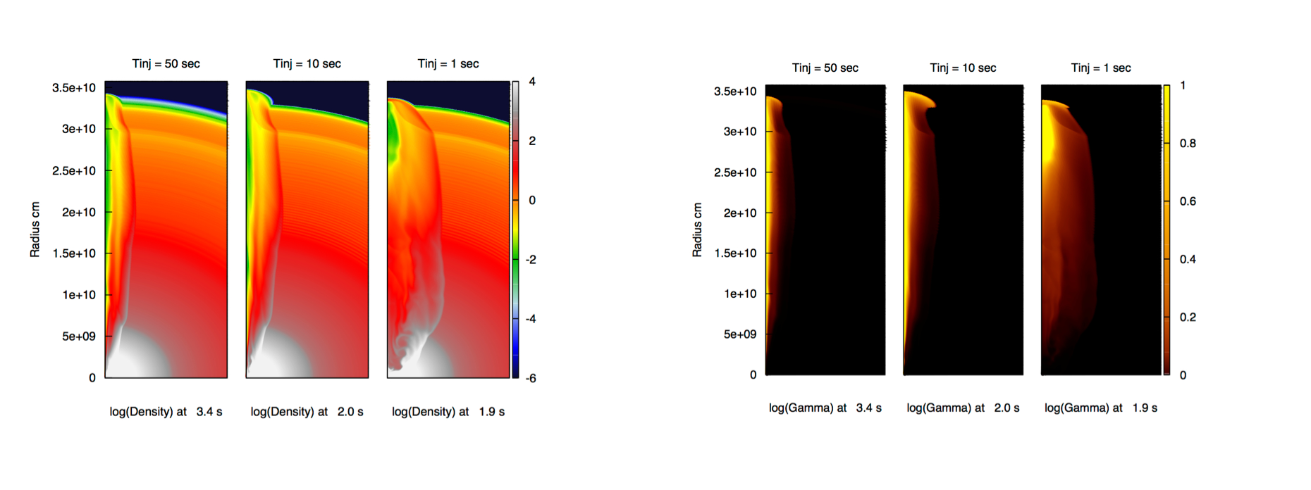
Jet at the breakout
Short engines favor sideways expansion
Intermediate engines have a good balance of power/collimation
Long engines are well collimated but have a small energy deposition
  Takes take to grow up

Slide 12
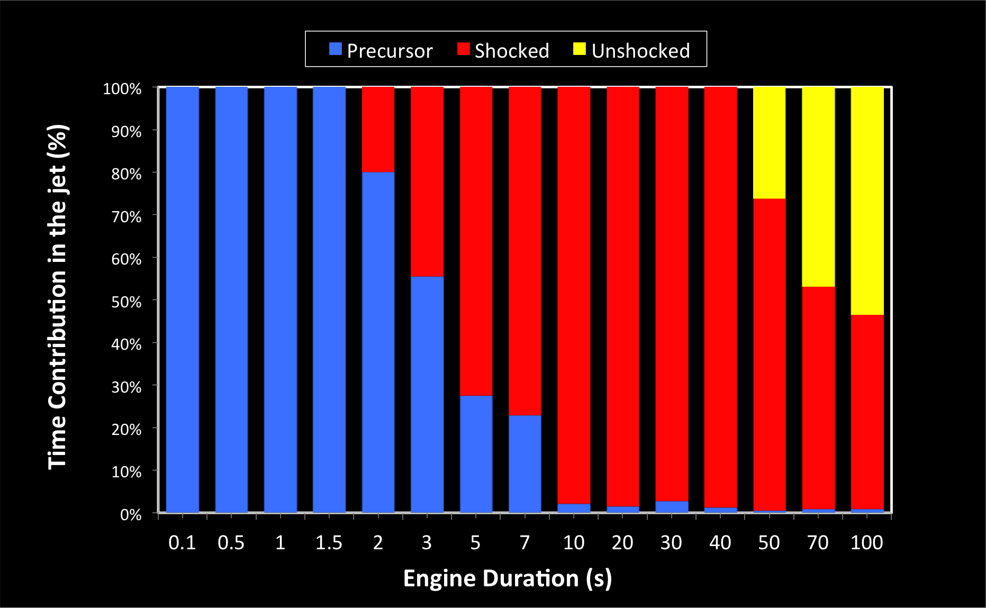
Jet Phases
Short engines:
  Only Precursor phase
    Precursor-like events
Intermediate engines:
  No unshocked phase
    High variability
Long engines
  Mixture of the three

Slide 13
Light Curve
As in Zhang et al., 2003 & Morsony et al., 2007, we measure the jet flux (Kinetic & Internal energy), at 1.2 10¹¹ cm from the star
Progenitor
Collapses
3.3 10¹⁰ cm
Relativistic jet (Γ)
Jet Flux
(at r = 1.2 10¹¹ cm)
Jet progressing in the CSM

Slide 14
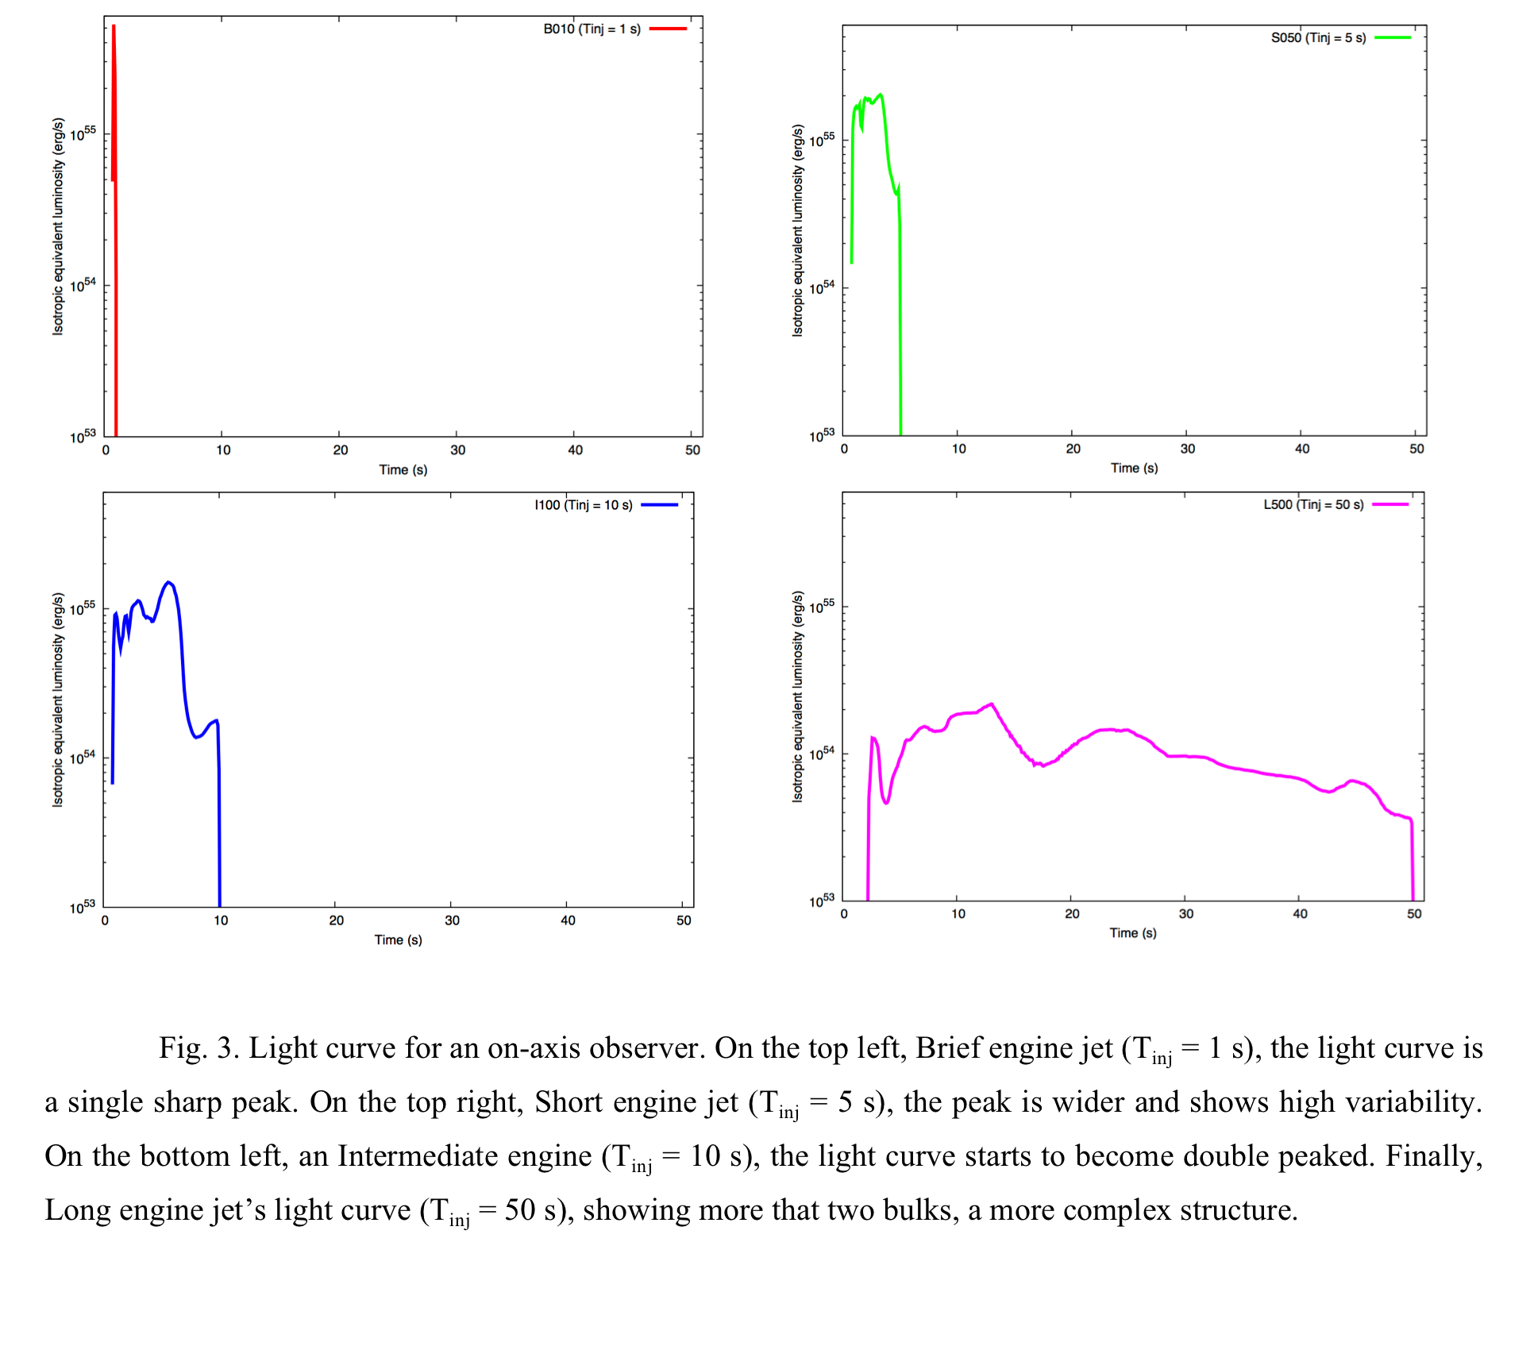
Light curves
Brief & Short:
  One sharp peak
Intermediate:
  Two main pulses (Strong precursor + Shocked phase)
  Variable
Long:
  Multi-peaked

Slide 15
Outflow properties

Slide 16
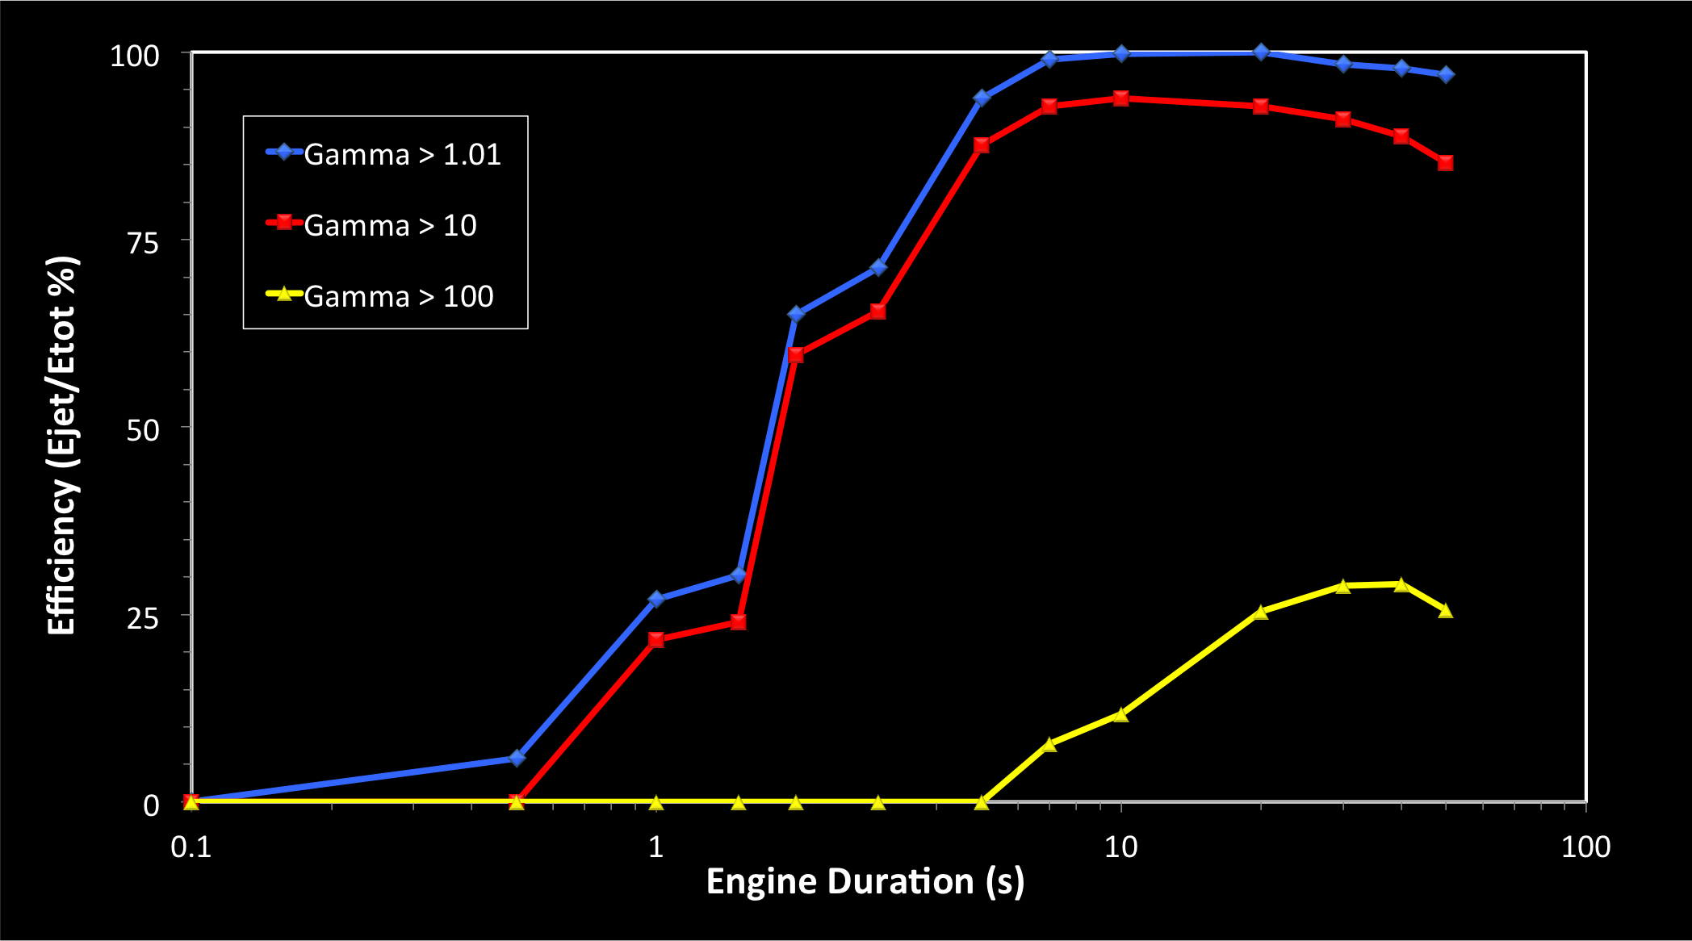
Relativistic acceleration efficiency
The longer the engine duration the more efficiently the outflow is accelerated
Short engines fail to produce highly relativistic outflow

Slide 17
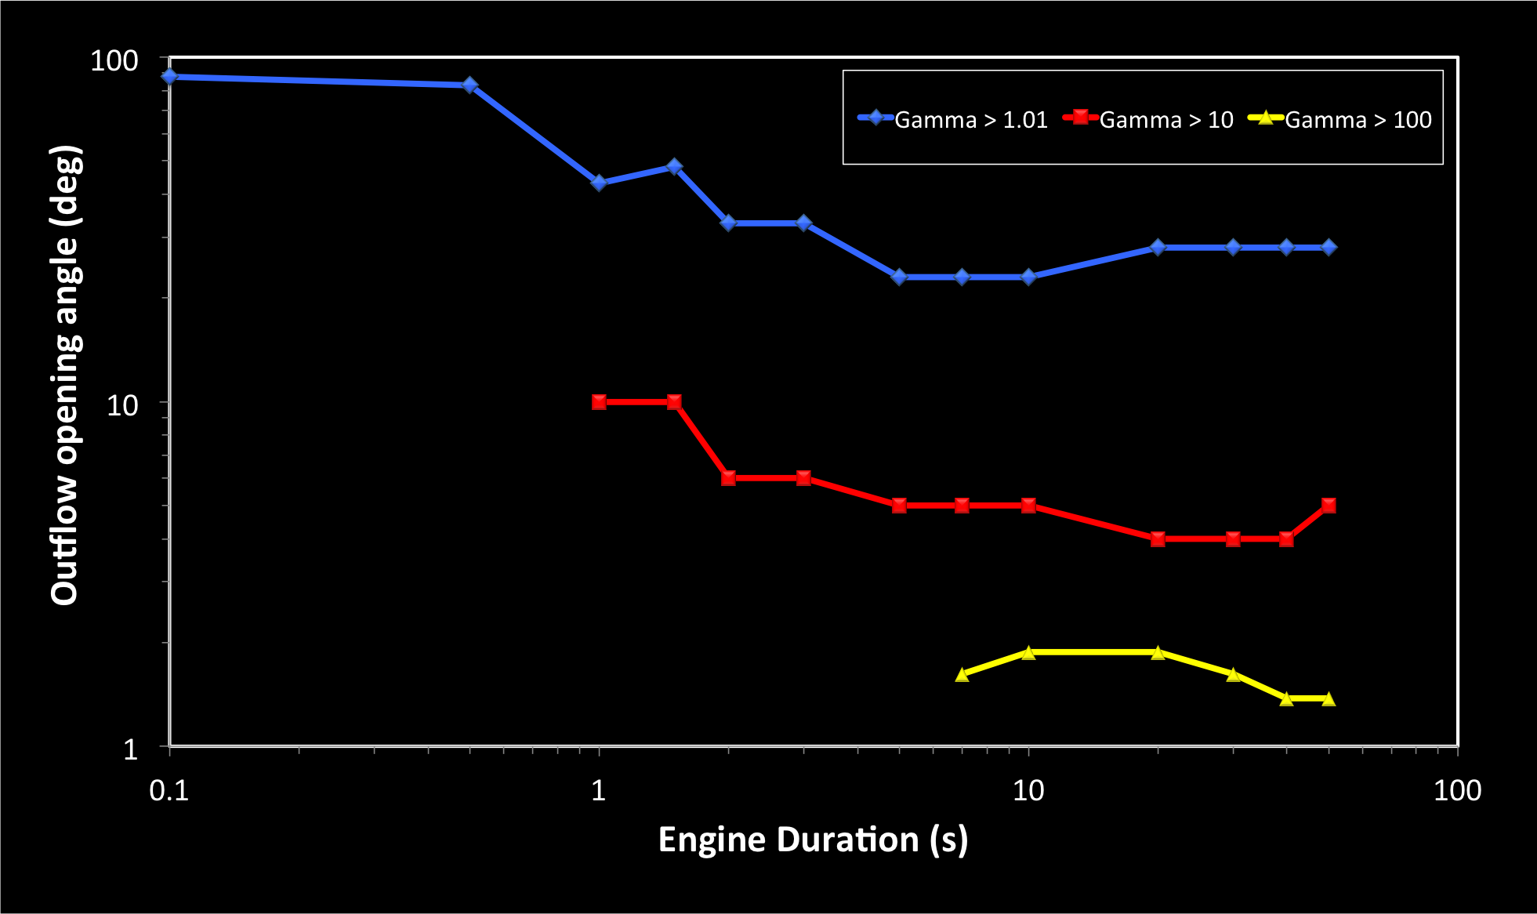
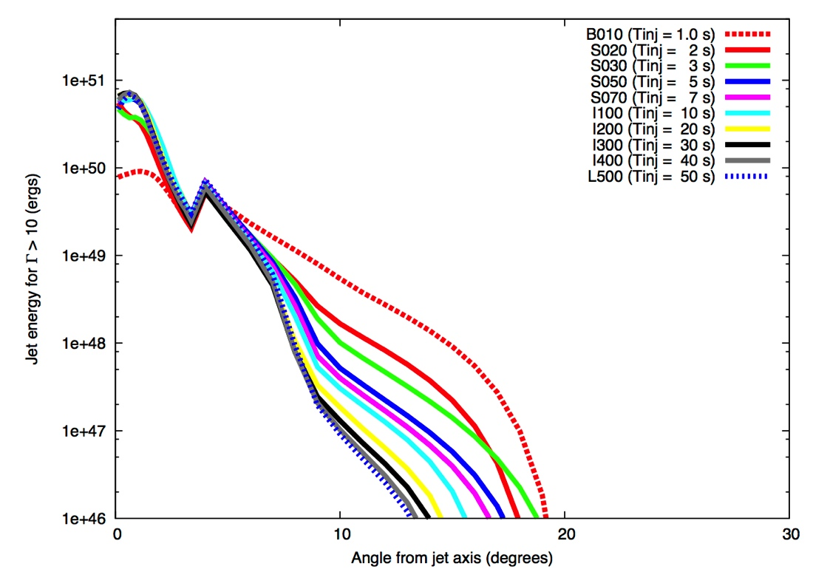
Angular Distribution
Engine | Short | Intermediate | Long
0 < θ < ~2-3° | 10 < Γ < 100 | Γ > 100
2-3° < θ < ~10° | 10 < Γ < 100
10° < θ < 30-90° | 1.01 < Γ < 10
The longer the engine the more relativistic, collimated and energetic the jet is
Short engines wide jets suggest high-rates & Soft events
  llGRBs (?)

Slide 18
Low luminosity GRBs

Slide 19
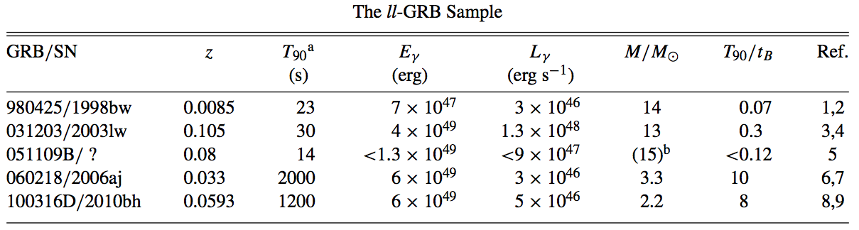
llGRBs
Few orders of magnitude softer than GRBs (typical LGRBs > 10⁵² ergs)
Soft spectrums & Smooth light curves (single pulse)
Accompanied by broad line type Ic SNe
Only at very low redshifts (due to their low luminosities)
Rates estimated as 100-1000 times higher than LGRBs
  ~230 Gpc⁻³ yr⁻¹ due to the very low redshift (Soderberg et al., 2006 & Bromberg et al., 2011 and the references within)
What is making all these events?? Which engine??
Credit: Bromberg et al., 2011

Slide 20
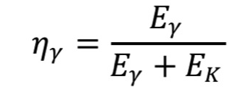
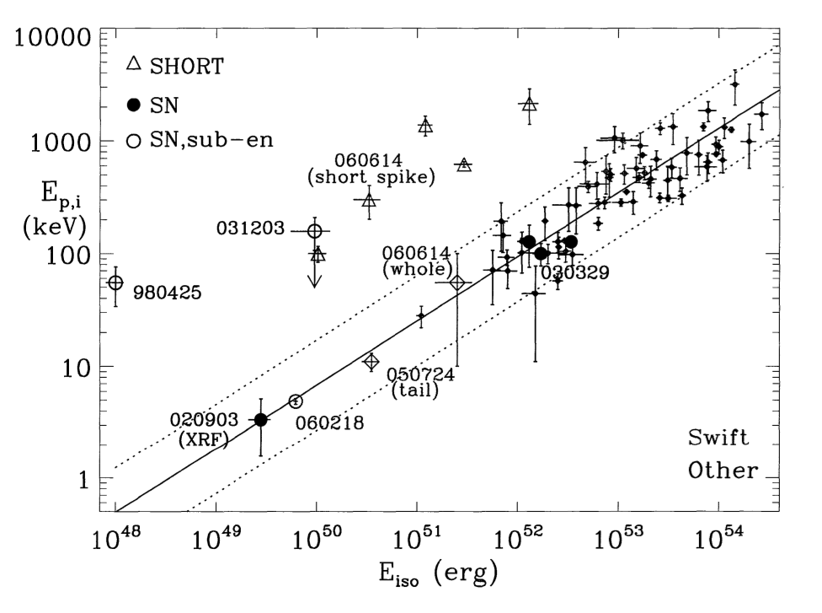
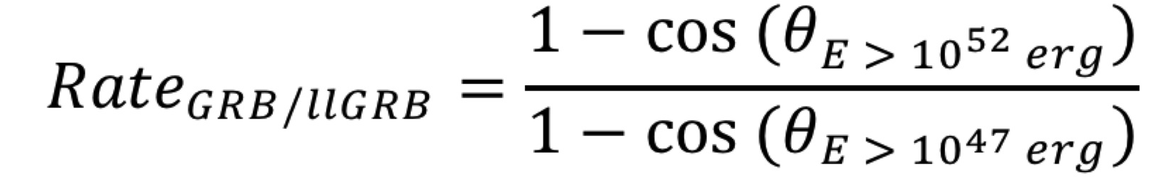
Two Assumptions
1: A radiative efficiency of 1% for the outflow with Gamma > 10 (Zhang et al., 2007 & Morsony et al., 2010)
2: The Prompt emission is released just after the breakout at a small radius (R ~ 10¹¹ cm). (Lazzati et al., 2010)
Zhang et al., 2007
Amati et al., 2009

Slide 21


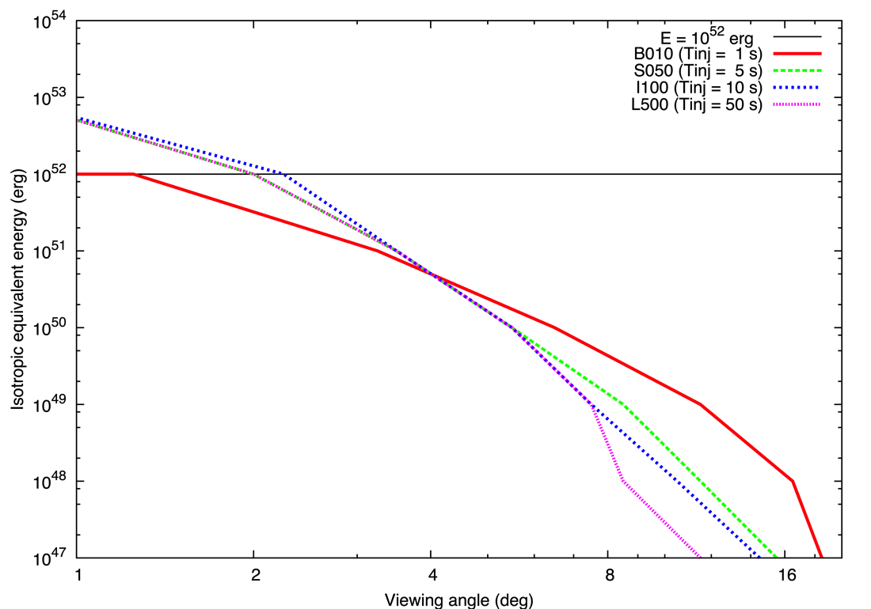
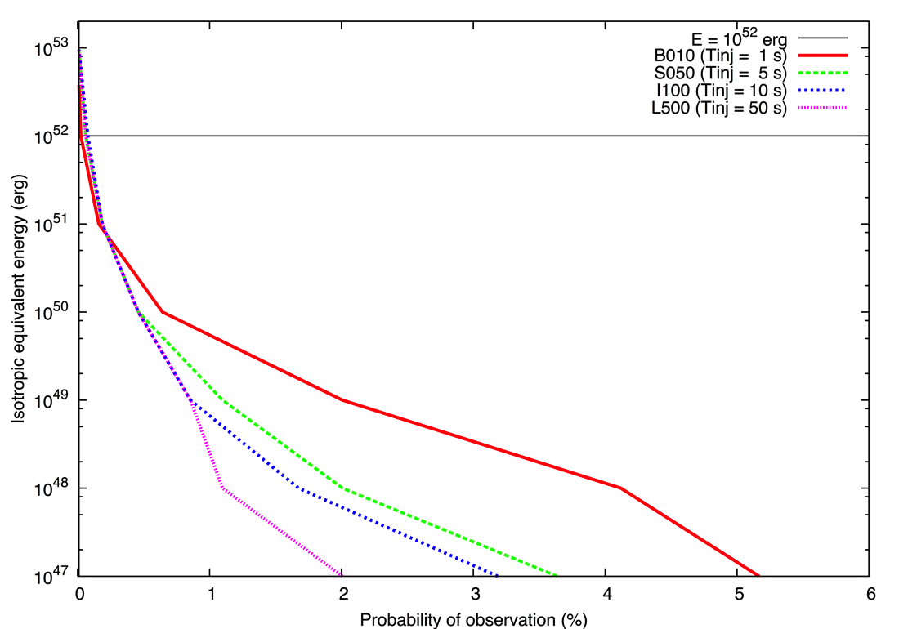
Opening angle & Probability
P(llGRB)
(E_{iso} ~ 10⁴⁷⁻⁴⁹ ergs )
P(GRB)
(E_{iso} ~ 10⁵² ergs)
The shorter the engine
  The wider E_{iso} is spread
  The softer E_{iso} tends to be.
Probability of observation
  High for short engines’ jets (x2.5 than long engines)
  Very high in llGRBs domain (10⁴⁷⁻⁴⁹ erg)
Central Engine
P(GRBs)
P(llGRBs)

Slide 22
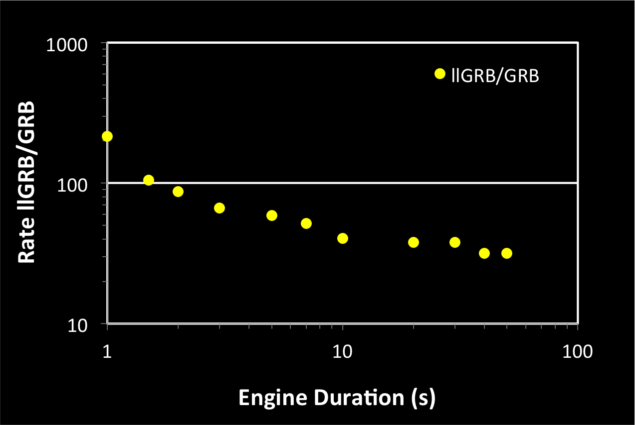
The Ratio llGRBs/GRBs
The Shorter the engine the higher the llGRBs rate
Only Short engines could reproduce llGRBs in the range of 100-1000 x GRBs

Slide 23
Summary
The engine duration shapes:
Light curve: The longer the engine, the more phases and complexity
Lorentz factor, Energy & Collimation:
  Short engines produce soft/wide jets
  Longer engines produce relativistic/energetic/collimated jets
llGRBs Rates:
  “With short engines we could reproduce/explain the high rates of llGRBs”
Engine | Structure/Light curve (on-axis) | Lorentz factor/Relativist Energy | Jet collimation | Comment
Short | Single peaked | Low | Wide jet (~20°) | llGRBs-like events at huge rates
Intermediate | Double peaked | High | Collimated (~ 10°) | High variability
Long | Complex | Highest | Well collimated (<10°) | Regular/Bright GRBs

